Slide 1

Weaponising News: RT, Sputnik and Targeted Disinformation
A project conducted at The Policy Institute, King’s College London, funded by the Open Society Foundation
Dr Gordon Ramsay and Dr Sam Robertshaw

Slide 2
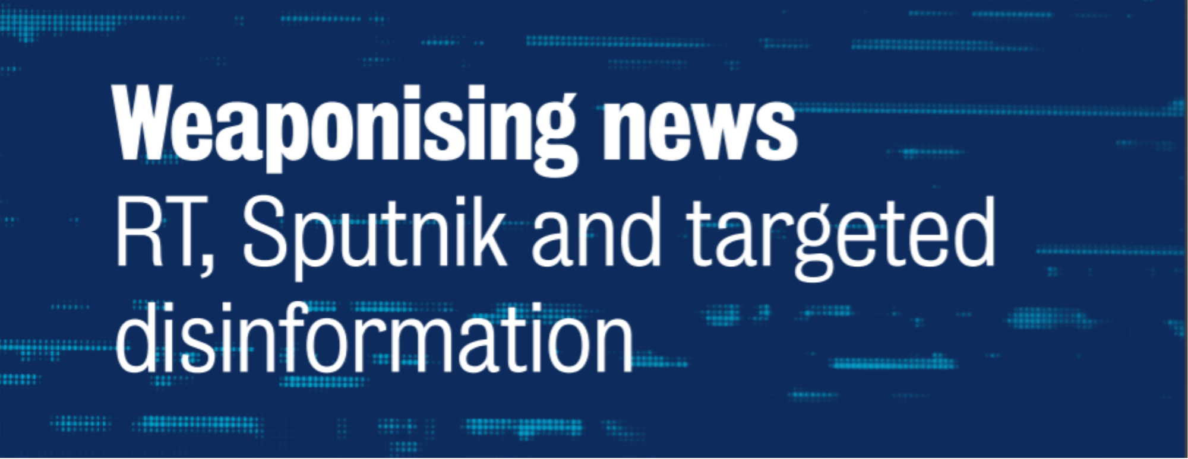
Overview and Findings
RT and Sputnik – English-language output
‘Damage limitation’ in the aftermath of the Salisbury poisoning
Intensive focus on Russian military strength, with measurable effects on news coverage in the UK
Consistent framing of European democracies as dysfunctional, repackaged and pushed at English-speaking audiences.

Slide 3
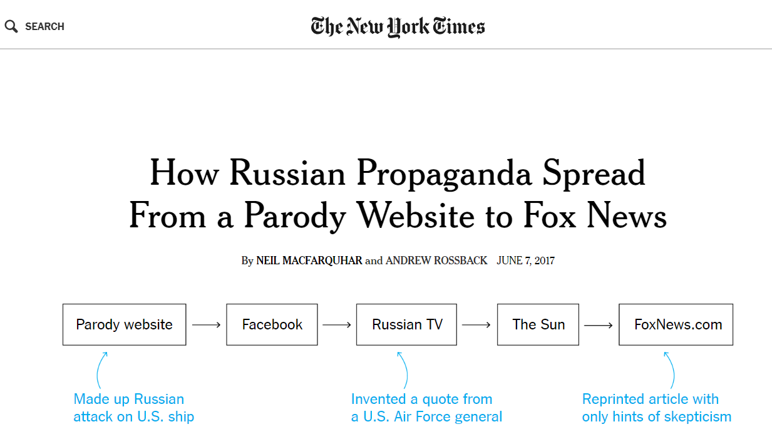

Slide 4
Project origins & aims
NYT article (June 2017): Journalism as source and vector of disinformation
‘Churnalism’: Leveraging vulnerabilities in Western news org
Salisbury incident: Journalism as a crisis management tool
Motive, Resources and Means
Research Questions
What can be learned from large-scale analysis of how Russian outlets present news, in English, to the world?
Is there evidence of direct content replication?

Slide 5
Introducing Steno
Stenoproject.org
Three-part news content collection and analysis tool:
Collection and retrieval – Scrapeomat
Retrieval and analysis – Steno GUI
Matching and comparison – Steno-Similar

Slide 6
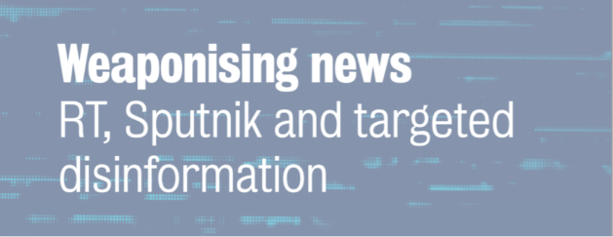
Sampling and analysis
2 Russian sites: rt.com, sputniknews.com
17 UK sites: National broadcasters and press; 2 large digital-only outlets
8 week-long datasets – 151,809 UK news articles; 11,819 from RT/Sputnik
- May-June 2017; March 2018
Skripal coverage (Content analysis and text fragment-matching)
NATO and Russian military (Frame analysis and dataset-matching)
Dysfunction and agenda-building (Frame analysis and dataset-matching)

Slide 7
1. Skripal Coverage – ‘Flooding the zone’
735 articles published by RT and Sputnik in the four weeks after the incident
138 separate and often contradictory narratives; clustered in response to external events
215 separate sources – a ‘parallel commentariat’
Narrative Groups:
Novichok (20 narratives)
UK/West response (32)
Geopolitics/Conflict (26)
Skripals’ behaviour (16)
Western domestic politics (15)
Russia’s response (11)
Conspiracies (7)
Alternative narratives (11)

Slide 8
1. Skripal Coverage – (Selected) Novichok Narratives
The Novichok used was from Porton Down
The Novichok used was not made in Russia
The Novichok used may be Russian, but was not made by the state
The Novichok could be from any other post-Soviet state
The Novichok could be from a Western country (e.g. Sweden)
The Novichok could be from Iran
The Novichok used was definitely developed in the USA
Novichok was initially created by the UK and US, not Russia
The nerve agent used was definitely not Novichok
The Novichok programme never existed

Slide 9
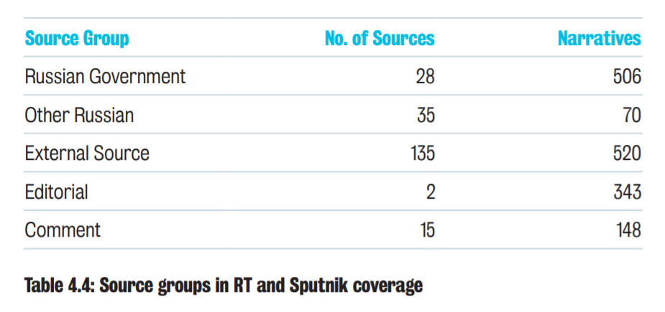
1. Skripal Coverage – ‘Parallel’ sources

Slide 10
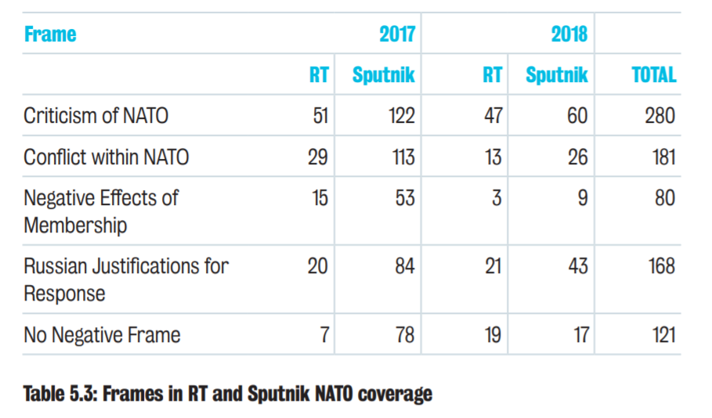
2. Military Coverage - Framing NATO
617 articles in total
80% contained one or more negative frames
Paradox: NATO Aggressive yet weak; dangerous yet incompetent

Slide 11
2. Military Churnalism
RT and Sputnik coverage of Russian military contains detailed information on weapon capabilities
Elite source quotes from Russian government, military and arms industry figures
Images and A/V content frequently embedded

Slide 12
2. Military Churnalism
10 UK articles replicated significant portions of RT or Sputnik articles on Russian military matters
Replication detected using Steno-similar with a match factor of 10%
6 acknowledged the source; 4 did not
One article, six days after the Salisbury poisoning, based almost entirely on RT article on Russian weapons
Express, 10th March 2018
Daily Mail, 12th May 2018

Slide 13
3. Frames and Agendas: Western Dysfunction
Frame analysis: ‘Political Dysfunction’ – 11 frames, grouped as:
  Conflict (political, institutional and social)
  Failure (political, military and public/private institutions)
  Alienation (Corruption, violence, inequality, anti-democratic practices)
82% of 2,641 articles about domestic issues in the UK, US, France, Germany, Italy, Sweden and Ukraine contained one or more ‘Dysfunction’ frames
Country-specific themes: Immigration and conflict in W. Europe; Violence and government failure in UK and US; Political failure and anti-democracy in Ukraine

Slide 14
3. Western Dysfunction: Agenda-Building
RT and Sputnik more likely to cover immigration, Islam, terrorism and racial tensions than UK media
Russian sources more often conflated immigration with Islam and violence/terrorism than UK media
Content harvesting by Russian outlets for English-language publication:
44% of articles about immigration in Germany from local sources
74% of articles about immigration in Sweden

Slide 15
3. Detecting Content Replication
‘Push’: Russian >> UK Media
21 articles with ≥30% match (factoring in quotes)
Only 2 cite source
All tabloids (Express: 13 articles)
11 articles about political issues and international events (including military)
‘Pull’: UK >> Russian Media
32 articles with ≥30% match
17 cite source
20 from broadcasters or quality press
22 about political issues; dysfunction frames common

Slide 16
Project Outcomes
Expanded empirical understanding
  Consistency of framing in key areas
  Selection and repackaging of content for target audiences
  Success in exploiting foreign media
  ‘Damage control’ in international crises
New tools for research and collaboration
Foreign language test

Slide 17
News as Disinformation
What is news? Definitional problems
  Schudson (2008) – Journalism should support the conditions in which representative democracy (and journalism) can thrive
Cross-border news provision
  New, easy to do, cheap (as an extension of foreign policy)
Journalism, vulnerabilities and exploitation
  Problems of intervention and definition
Regulation and power differentials
  Onora O’Neill (2012) – Communication rather than expression of content

Slide 18
Next Steps
Continued Exposure: All journalism is bound by its record; ‘infallible’ journalism even more so
Joined-up Research: Parallel analyses; cross-country collaboration; bridging to social media
Filling the gaps:
Russian domestic news feedback
News agencies
Alternative news sites
Beyond nation-states (motive + resources + means)

